Slide 1

⁠Classifying Failure Types in Hydraulic Systems
Naan Mudhalvan
Nishanthi - 2023108049
Mathesh - 2023108050
Surya Kiran - 2023108051
Samyuktha - 2023108052
Dilip Adhitya - 2023108053
-

Slide 2

Problem Statement
The task is to predict failure types in hydraulic systems using operational data.
We aim to classify failure types (e.g., Overheat, Low Fluid, Mechanical) based on features such as material thickness, pressure applied, temperature, and other operational data.
The dataset for this project contains 2200 records.

Slide 3

From Early Algorithms to Modern
Dataset Introduction
Dataset: Condition Monitoring of Hydraulic Systems
From : UCI mlr
Description: This dataset includes information about the condition of hydraulic systems used in various industries. It contains features such as pressure, temperature, fluid level, vibration, and more, to monitor the health of the hydraulic system and predict potential failures.

Slide 4
Charts from Data Analysis

Slide 5
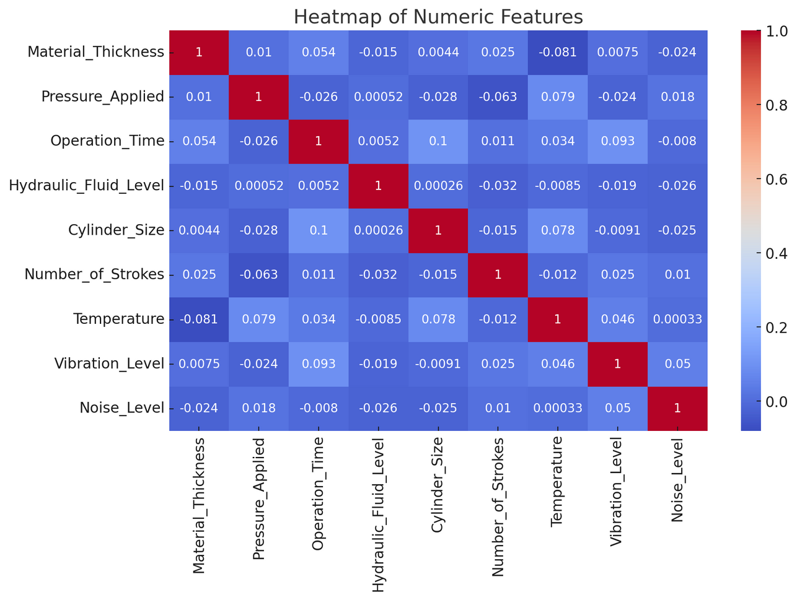
Heatmap: Correlation between numeric features

Slide 6
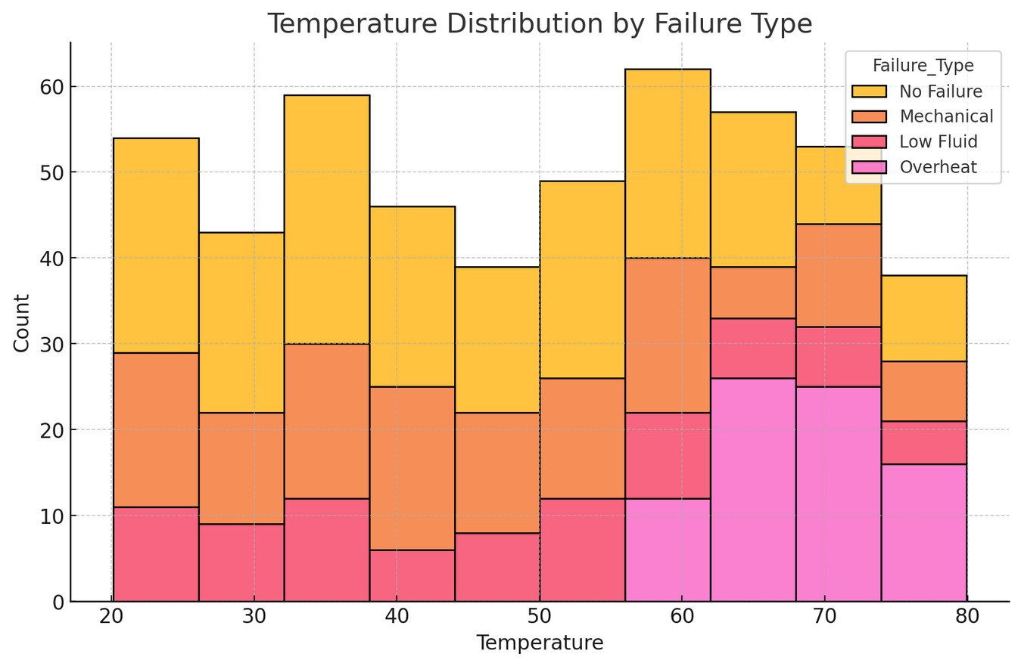
Histogram: Distribution of temperature by failure type.

Slide 7
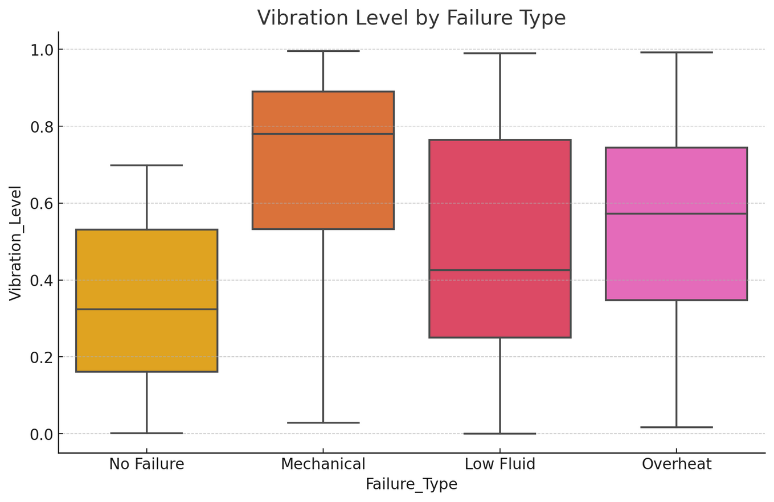
Boxplot: Vibration level by failure type.

Slide 8
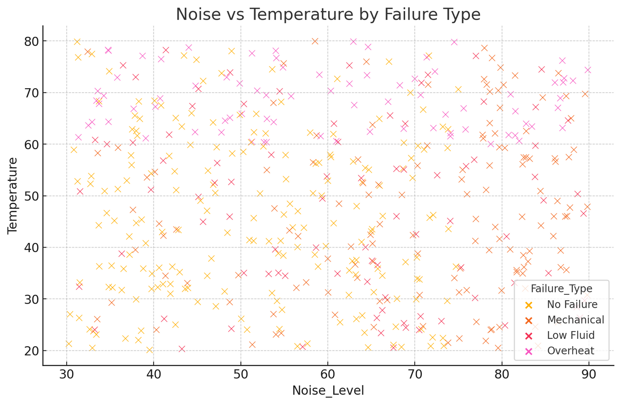
Scatterplot: Noise vs. Temperature by failure type.

Slide 9
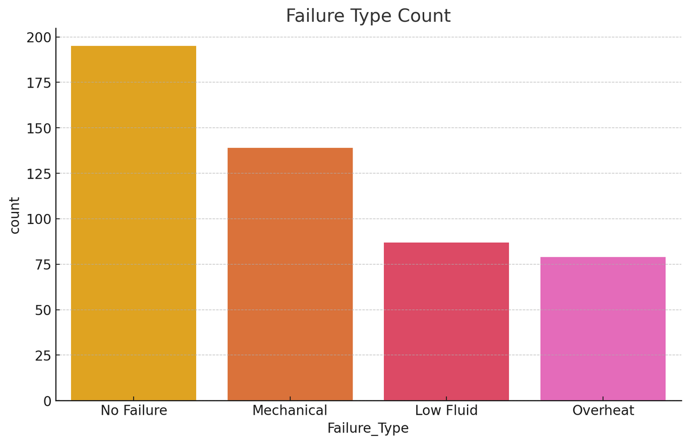
Countplot: Distribution of failure types.

Slide 10
Logistic Regression: Used for baseline classification. 0.724
Random Forest: An ensemble method, good for handling complex datasets. 0.91
Decision Tree: Helps in understanding decision boundaries for classification. 0.872
Support Vector Classifier (SVC): Focuses on maximizing the margin between classes. 0.76
K-Nearest Neighbors (KNN): A simple non-parametric algorithm. 0.802
XGBoost: A highly efficient gradient boosting algorithm for classification. 0.916
Algorithms Used for Data Analysis

Slide 11
Best Model Selection
Best Model: XGBoost with an accuracy of 91.6%.
Why XGBoost?
It outperformed other models in terms of accuracy and efficiency. XGBoost provides faster training times, scalability to larger datasets, and the ability to handle missing data effectively.

Slide 12
Key advantages of XGBoost:
High Accuracy: XGBoost consistently achieves high predictive accuracy, often outperforming other algorithms in various machine learning tasks.
Scalability: XGBoost is designed for large datasets and can handle millions or billions of instances and features efficiently.
Flexibility: XGBoost can be used for both classification and regression tasks, and it can handle various data types, including numerical, categorical, and missing values.
Regularization: XGBoost includes built-in L1 and L2 regularization techniques to prevent overfitting and improve generalization.
Feature Importance: XGBoost provides feature importance scores, allowing users to identify the most influential features in their data.
Benefits of XGBoost

Slide 13
Questions and Answers

Slide 14
Thank You

